Slide 1


Renaissance Services SAOG | MSX Investor Roadshow | September 2022
Investing in the future.
Creating value.
25+ years on MSX
DRIVING EFFICIENCY, PRODUCTIVITY AND
SUSTAINABILITY
IN THE
WORLD OF SERVICE SOLUTIONS

Slide 2
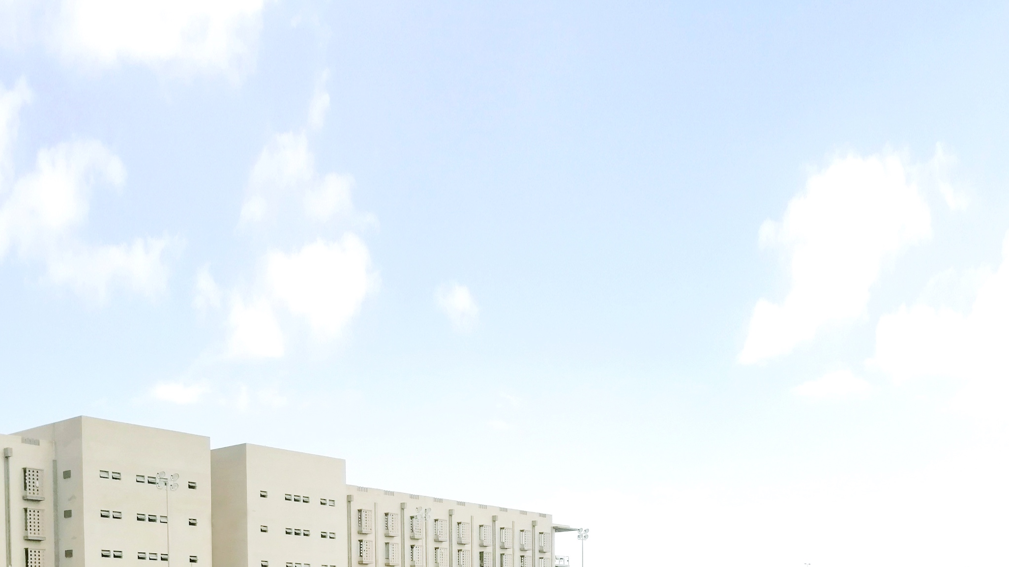
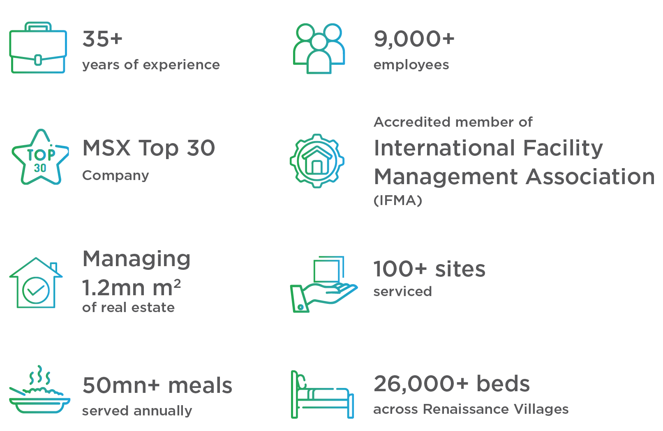
LEADING FROM
THE FUTURE
Renaissance Services is Oman’s
leading IFM, accommodation and
service solutions provider, with a
growing presence in the UAE
and Qatar.
US$520mn
Major domestic direct investor
US$390,000
CSR commitment

Slide 3
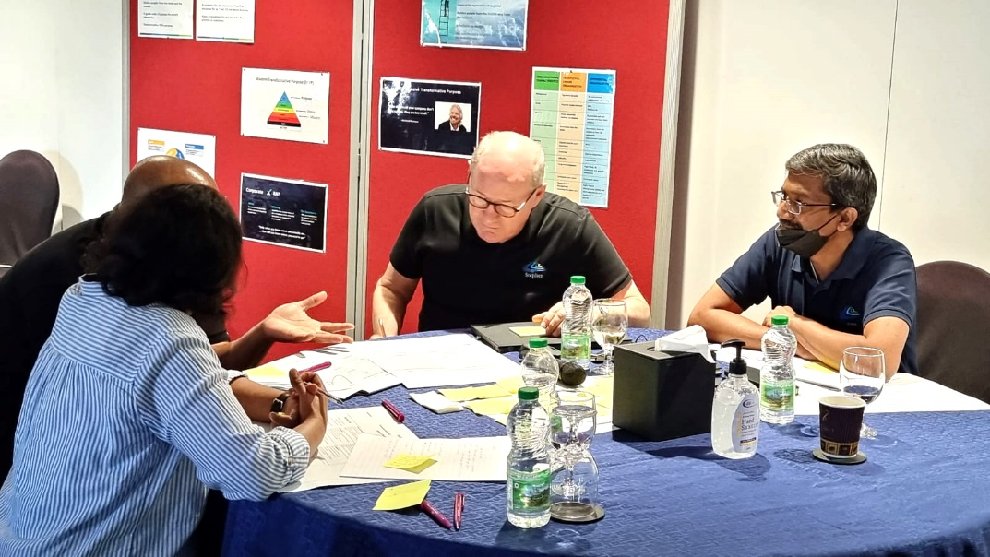

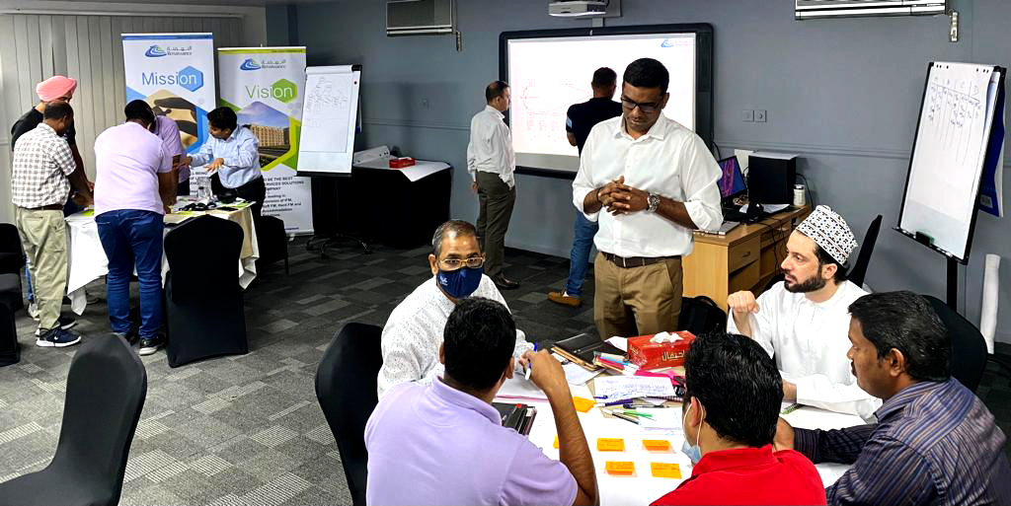
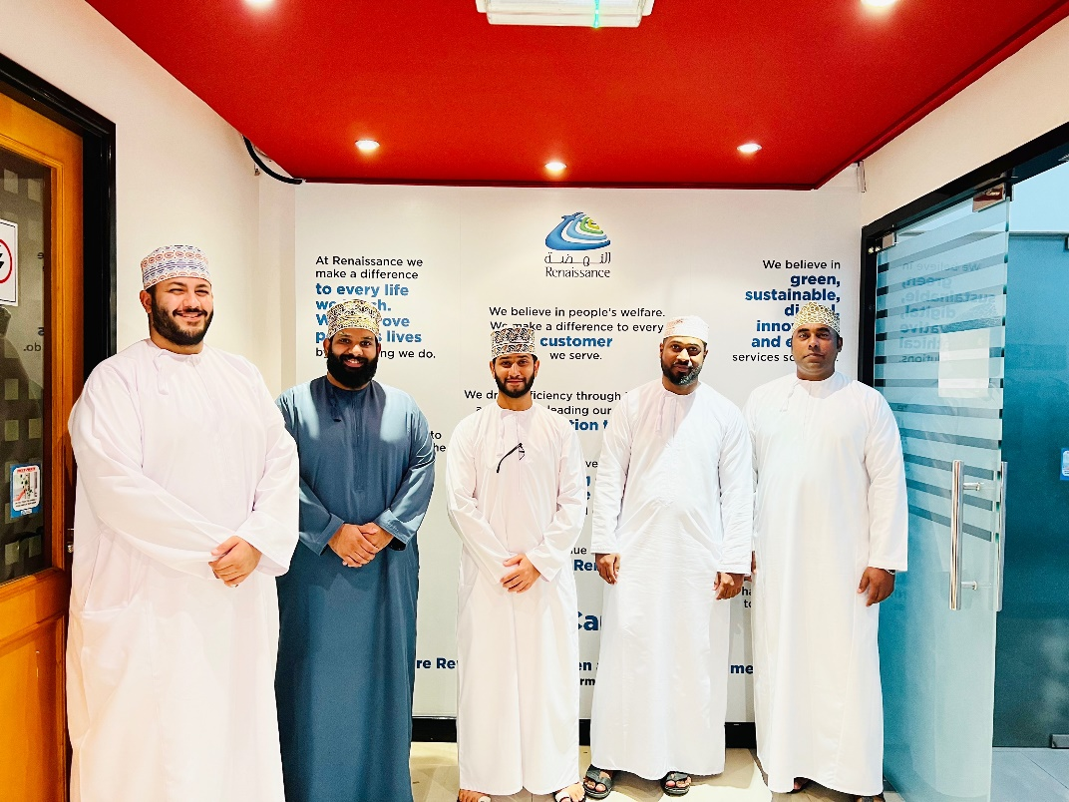

Slide 4
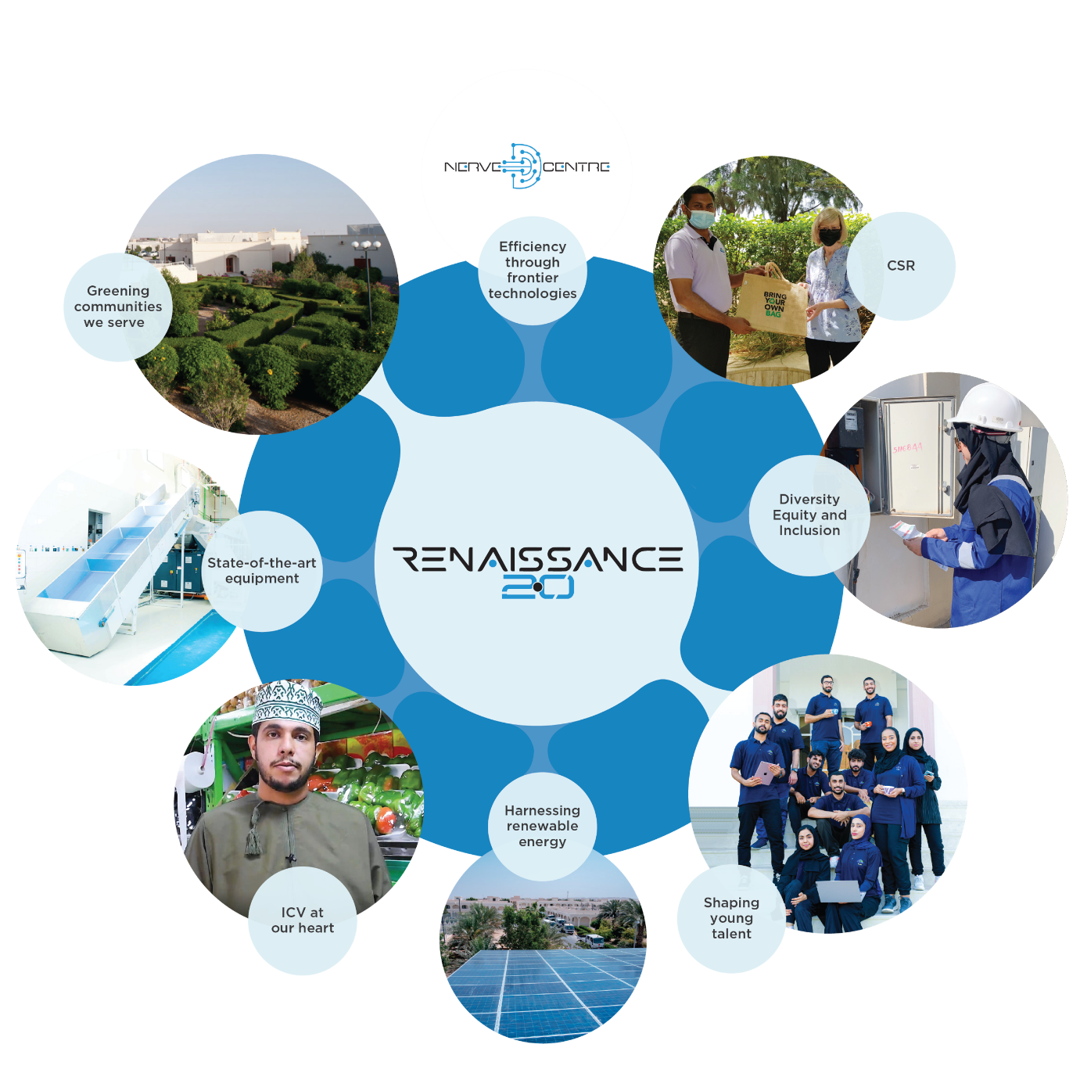
EXPERIENCES, ENVIRONMENT
AND EXPONENTIAL GROWTH
PURPOSE
VISION
Transforming every life we touch.
Lead the future in smart sustainable service solutions.
OUR VALUES
OUR COMMITMENT
S Safety
E ESG
R Respect
V Vision
I Integrity
C Caring
E Empowerment
Safety
Efficient
Green
Local

Slide 5
GROWTH
Robust approach to corporate governance and transparent, and effective reporting
2022 is another year of progress.
Our operational performance has generated sustainable cash flows to meet all our commitments on time.
Clear focus on maintaining liquidity and improving long term operational efficiencies.
Operating margins have improved year on year reflecting resilient fundamentals of our core business despite Covid challenges and hyperinflationary environment.
We have a disciplined approach to long term growth and remain focused on delivering value.
1
Group Revenue
Well balanced blue chip client base offering long term and sustainable value proposition to clients
2
Group EBITDA
Liquidity position of the Group
is well preserved
3
Group Operating Profit
Sustainable profit through operational efficiencies
4
Investing for future growth
Disciplined investment to fuel growth
Debt to EBITDA
2.6x (2022E)
Fixed Assets

Slide 6
GROWTH
Robust approach to corporate governance and transparent, and effective reporting
Our financial discipline supported by operational performance has helped to strengthen Balance sheet with sufficient headroom for growth capital.
Well positioned to generate long term sustainable value for all our shareholders.
Leverage Profile
Healthy capital structure to support growth investments
Return on Equity
Solid growth indicator in an emerging market

Slide 7




RENAISSANCE CONTRIBUTES TO BUSINESS PERFORMANCE, ECONOMIC GROWTH, AND NATIONAL WEALTH
Well-managed and
maintained workplaces
Raising standards in
worker welfare and environments
Continuously adopting
best-in-class technologies

Slide 8
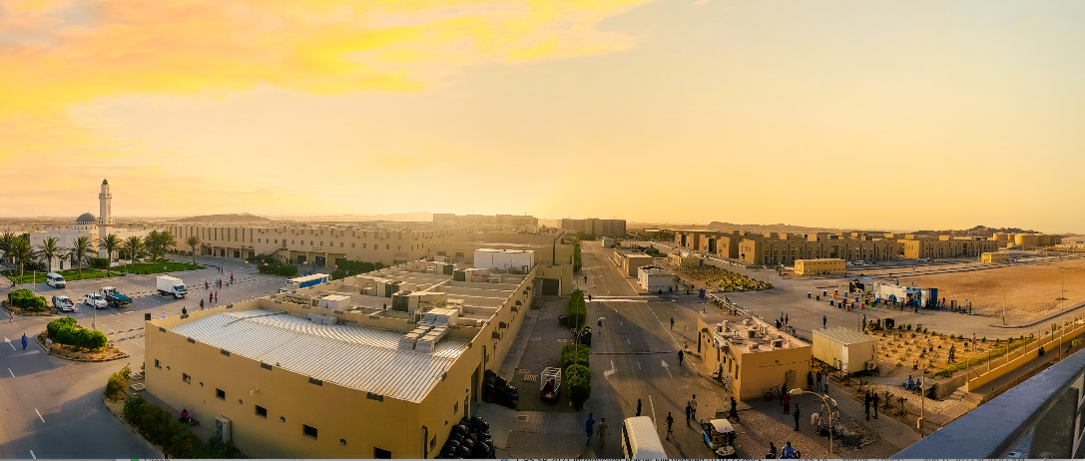
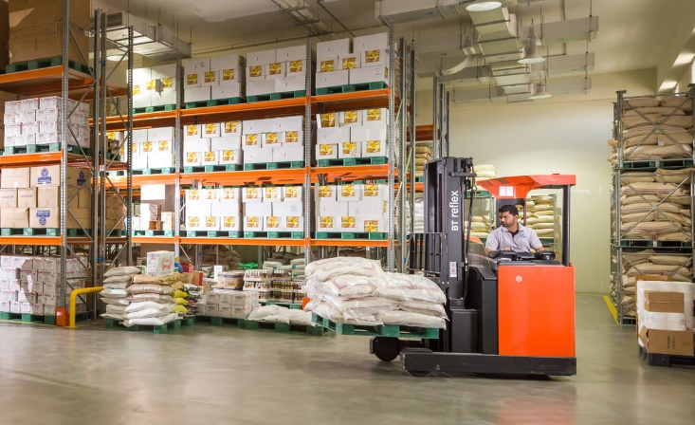
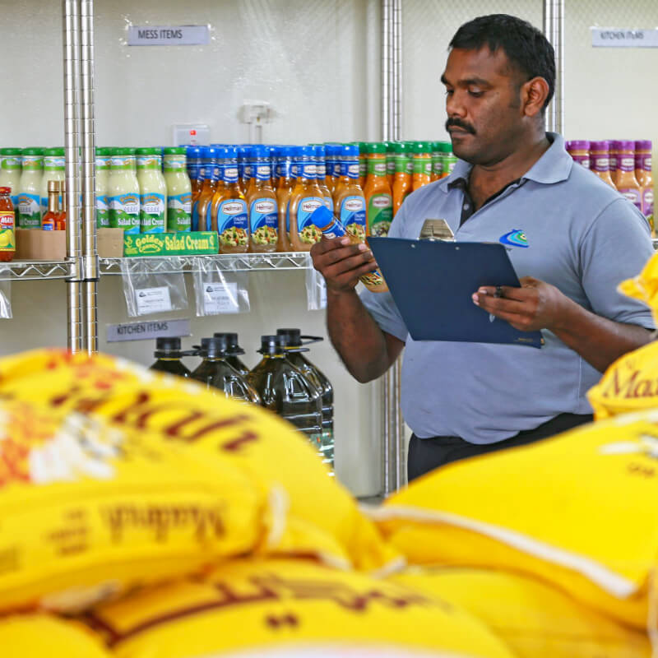
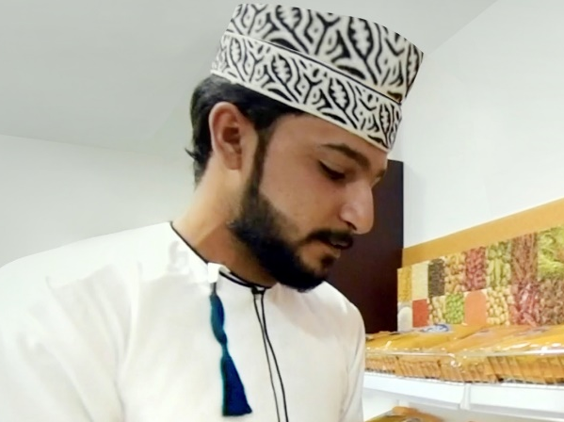
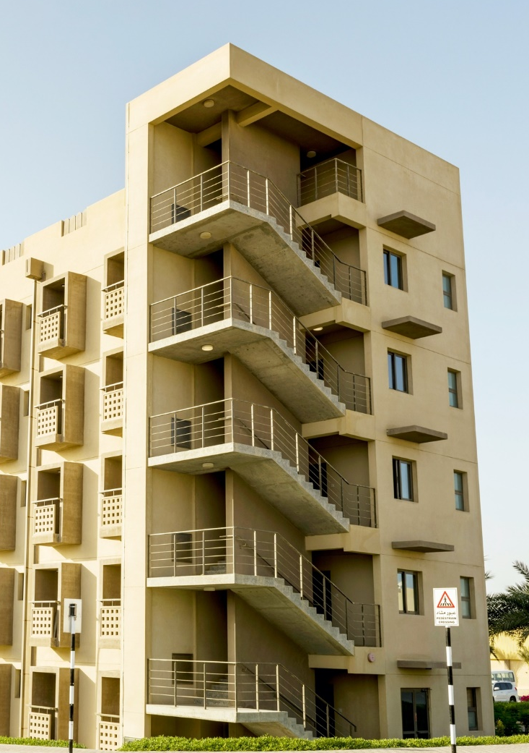
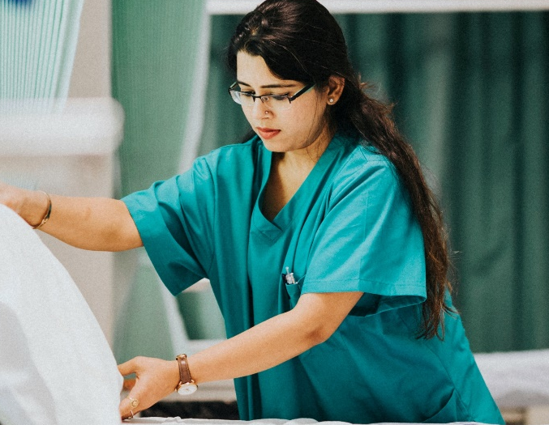
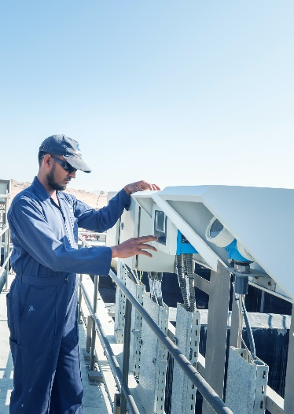
IN-COUNTRY VALUE
2,600+ Omanis
Sixth largest employer of
Omanis in the private sector
79%
Sourced from Omani suppliers
100+ locations
served across Oman
US$520mn+
Invested in assets in Oman
US$390,000
Annual CSR commitment

Slide 9



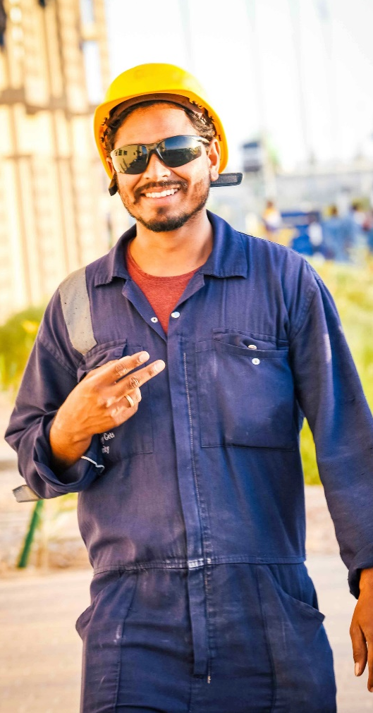
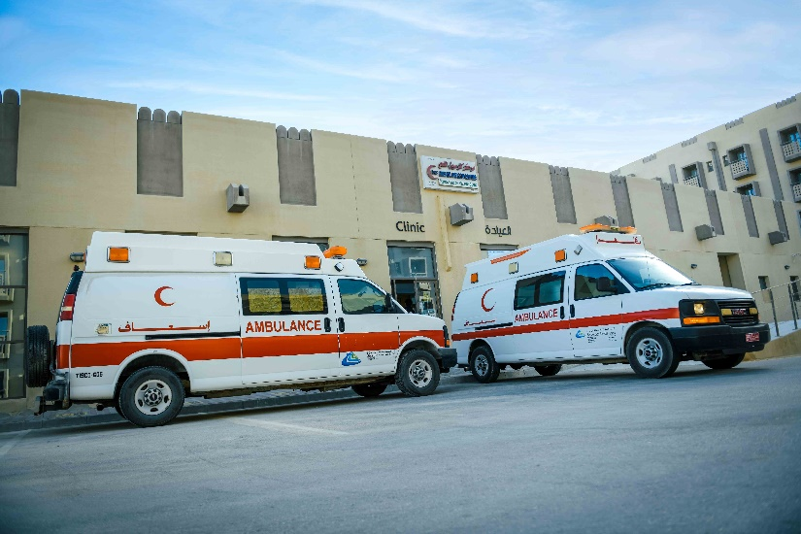
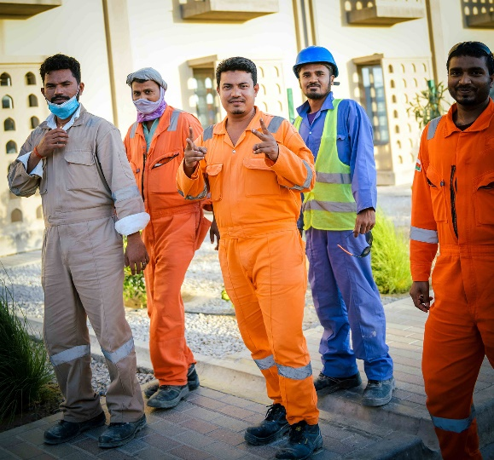
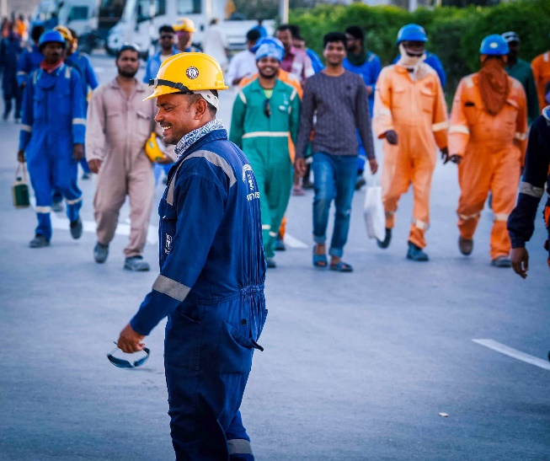
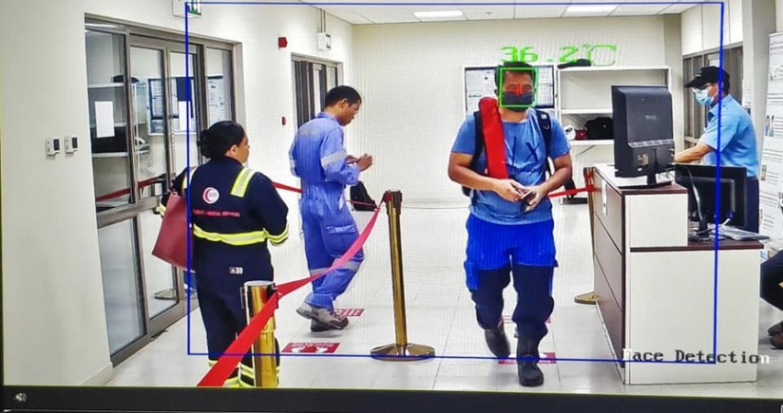
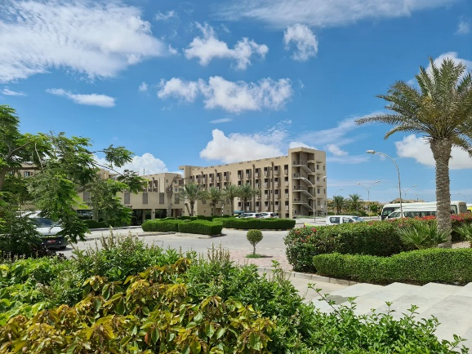
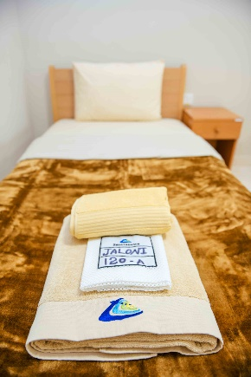
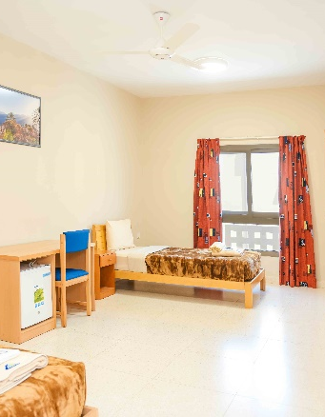
WORKER
WELFARE
Good for people, good for business,
growth for the economy, and progress for the nation
Global
Standards

Slide 10
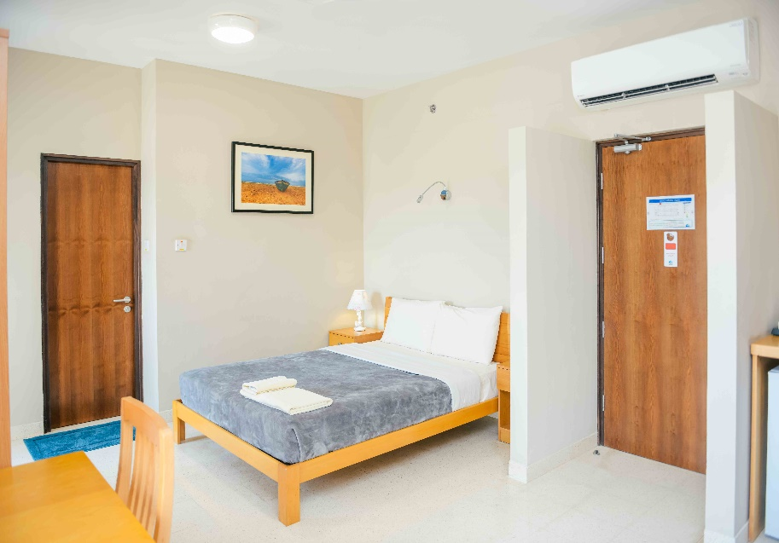
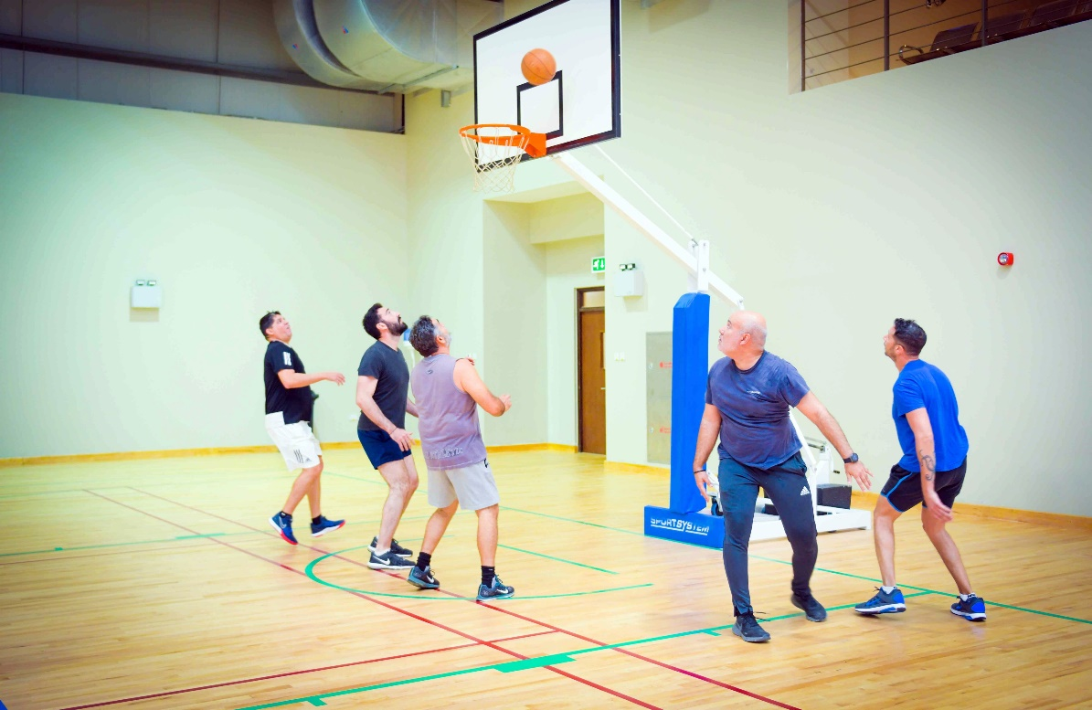
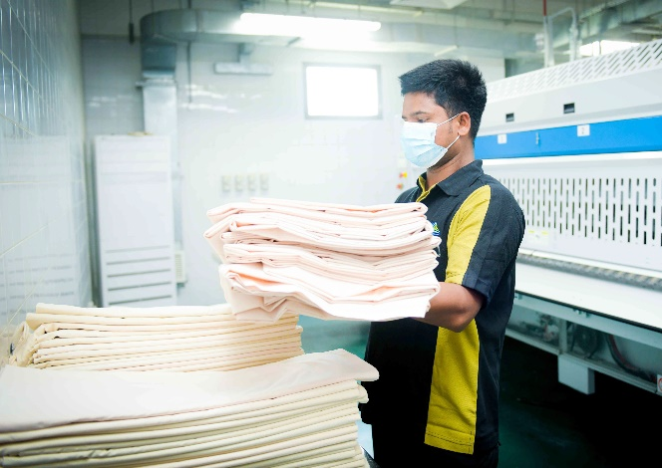
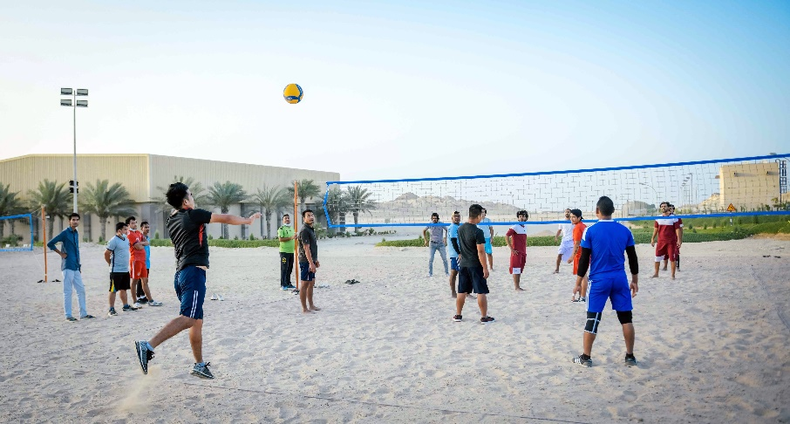
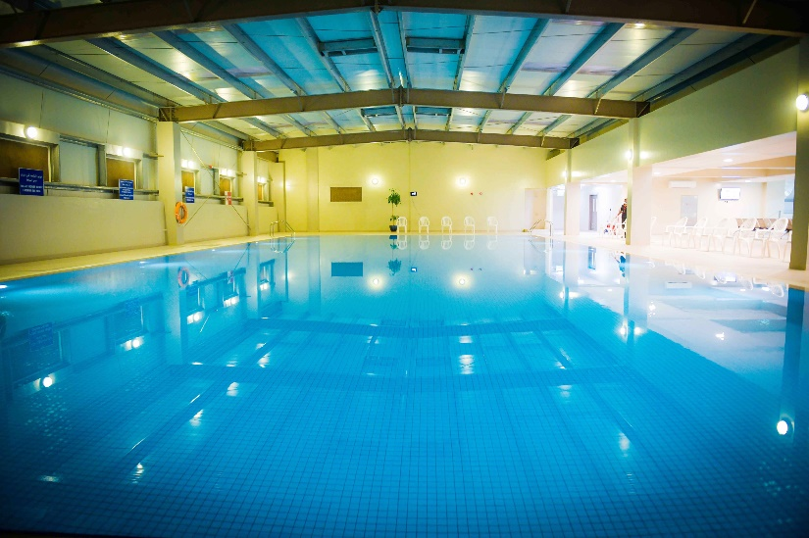
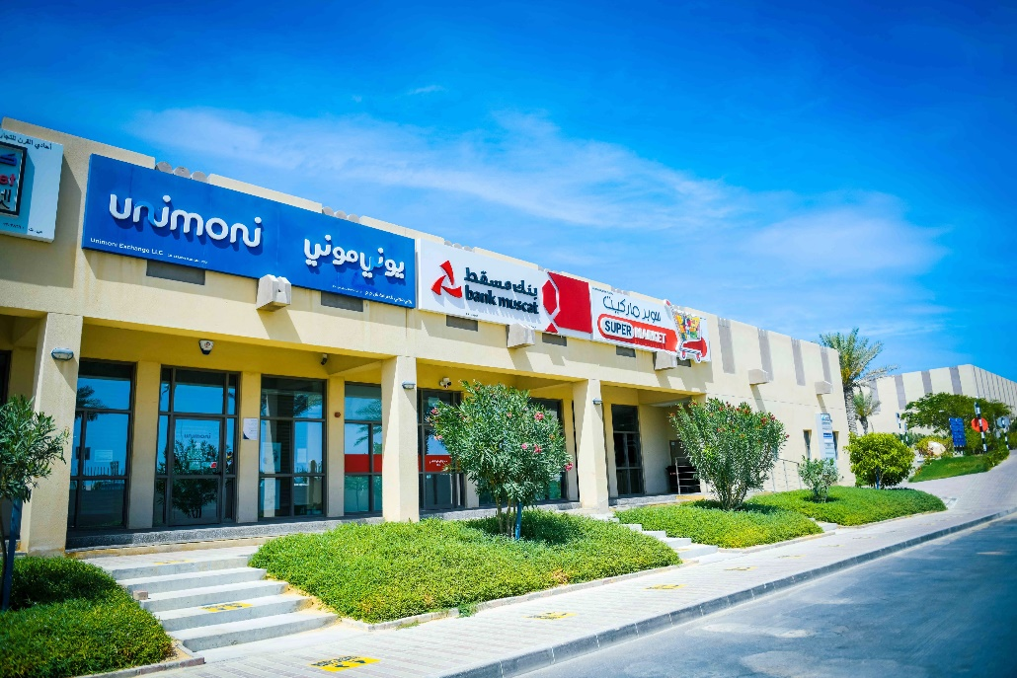

Slide 11
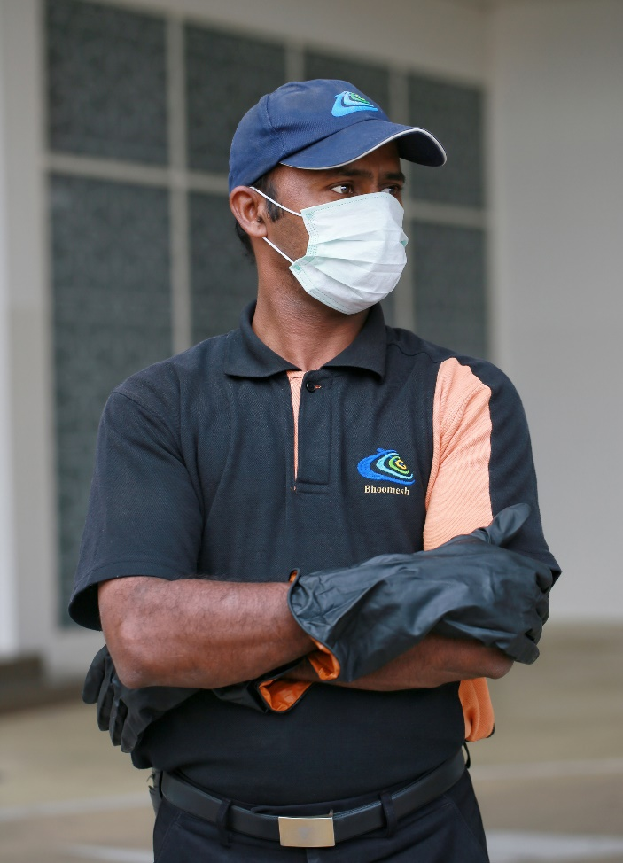
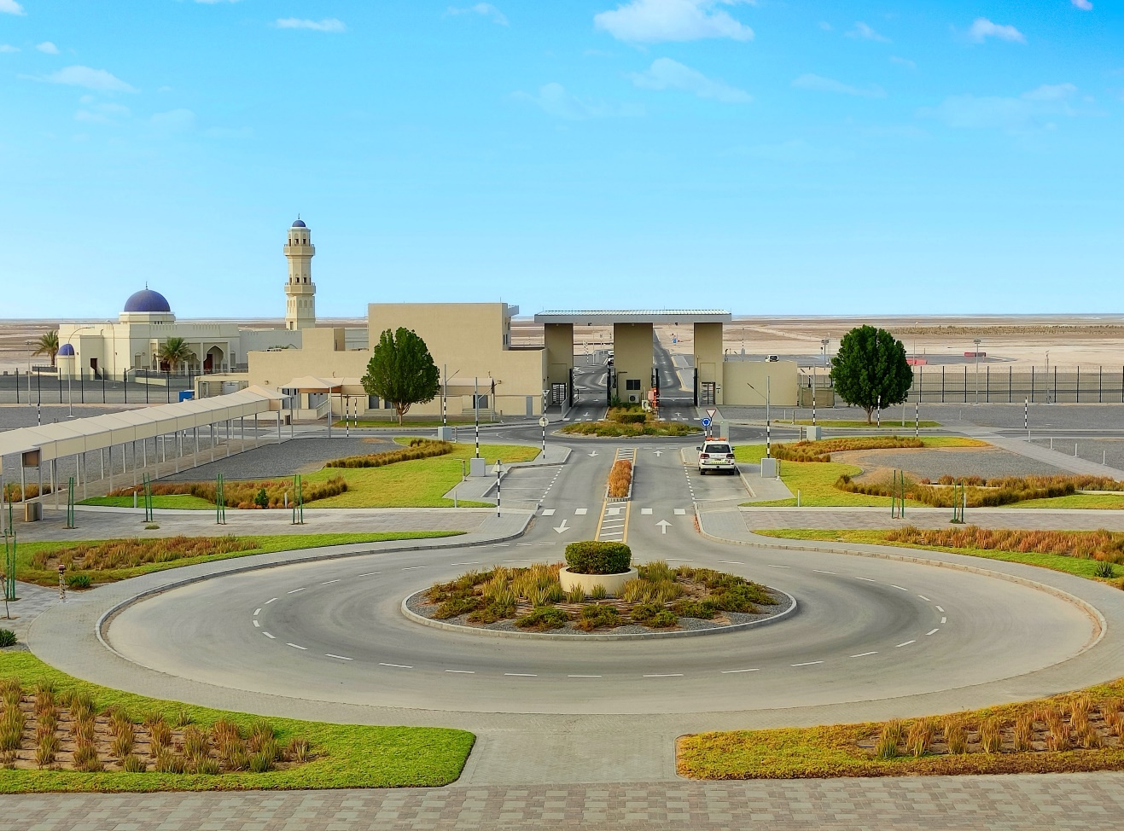
LIFECYLE
VALUE
Services solutions that enhance organisational performance
We deliver all non-core services
32+
Years of experience
9,000+
Full-time staff
ISO 9001
Quality Management System
100,000+
Assets serviced annually
3 million m²
BUA managed

Slide 12
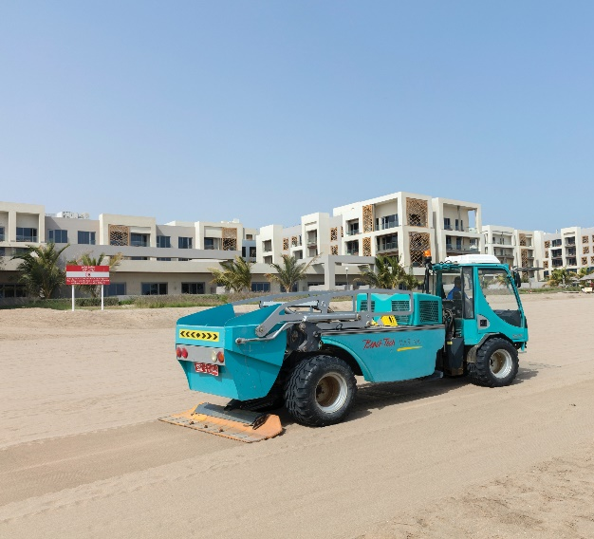
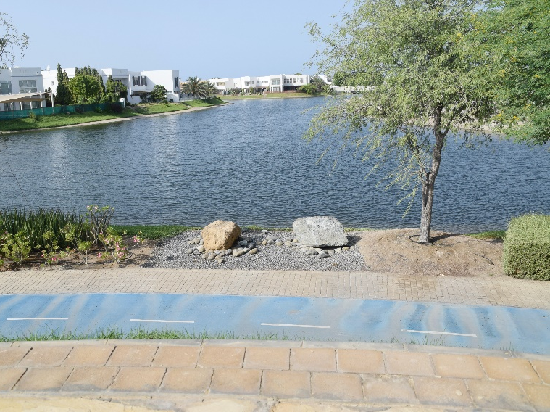
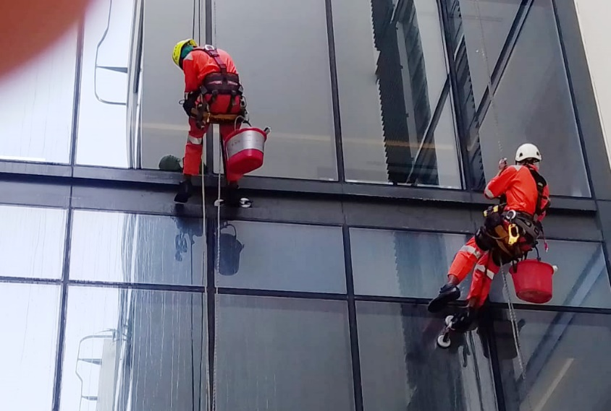
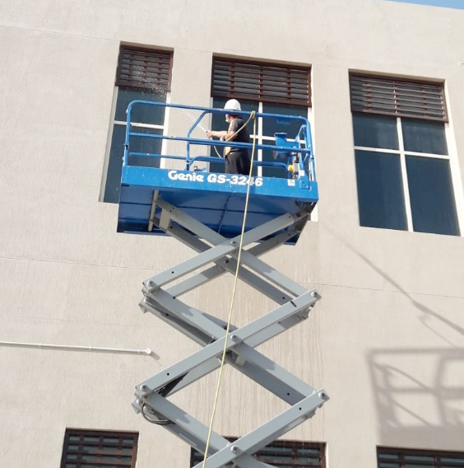
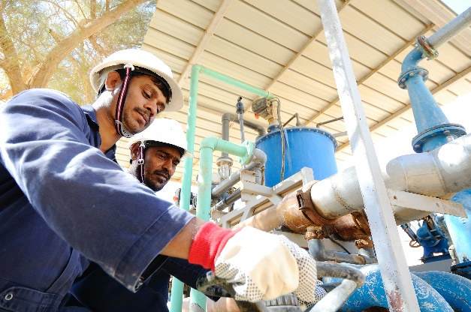
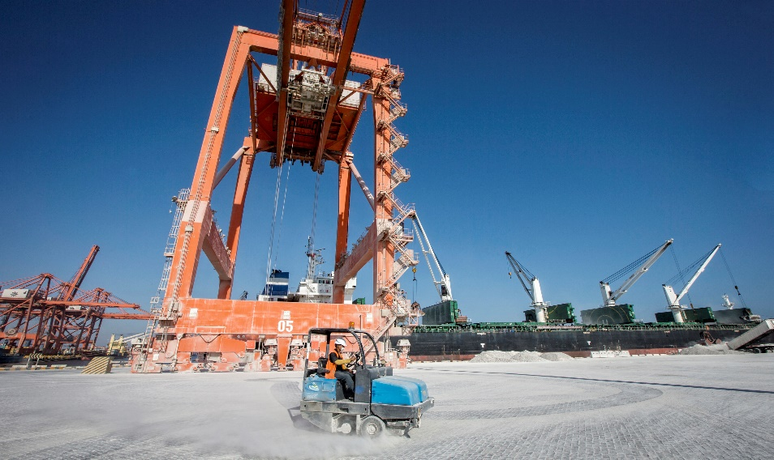
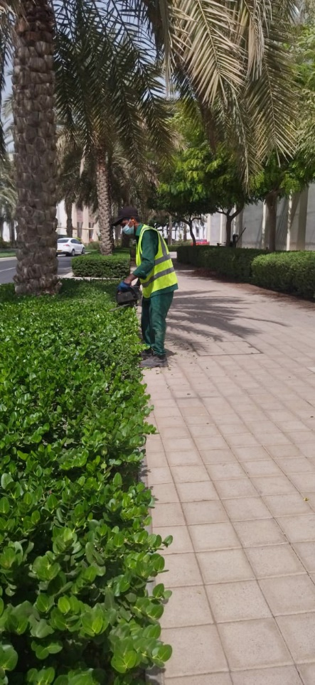
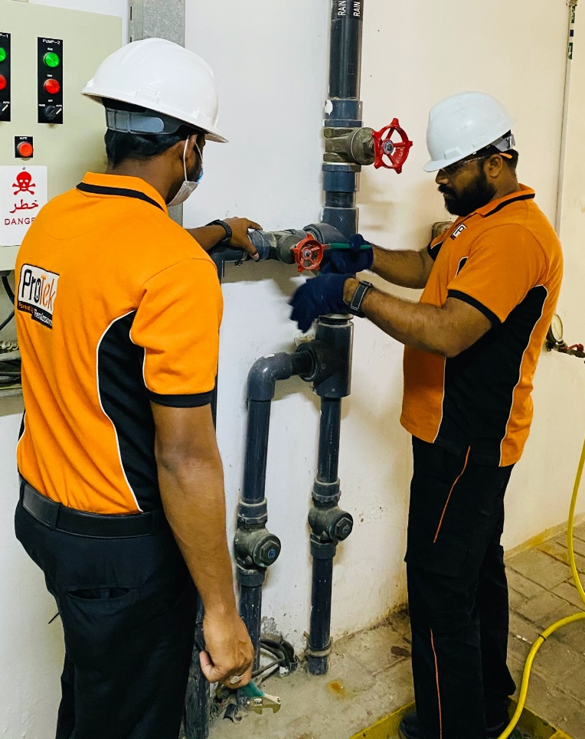
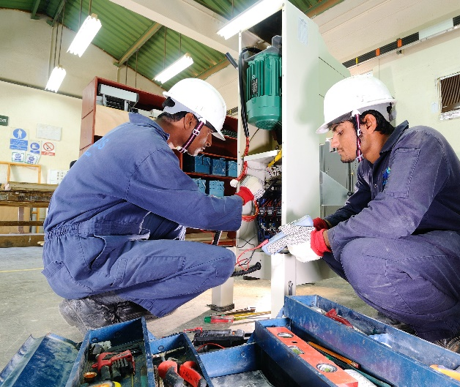
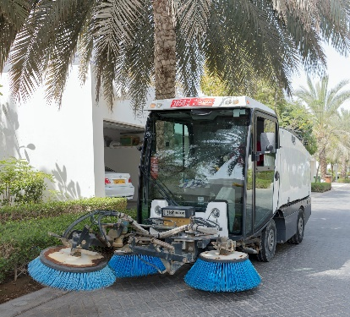
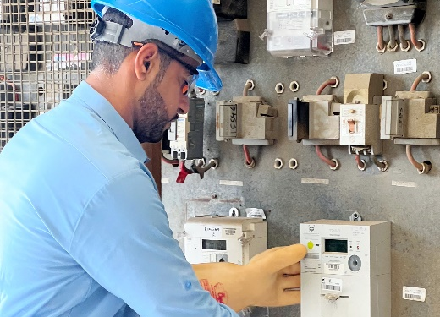

Slide 13

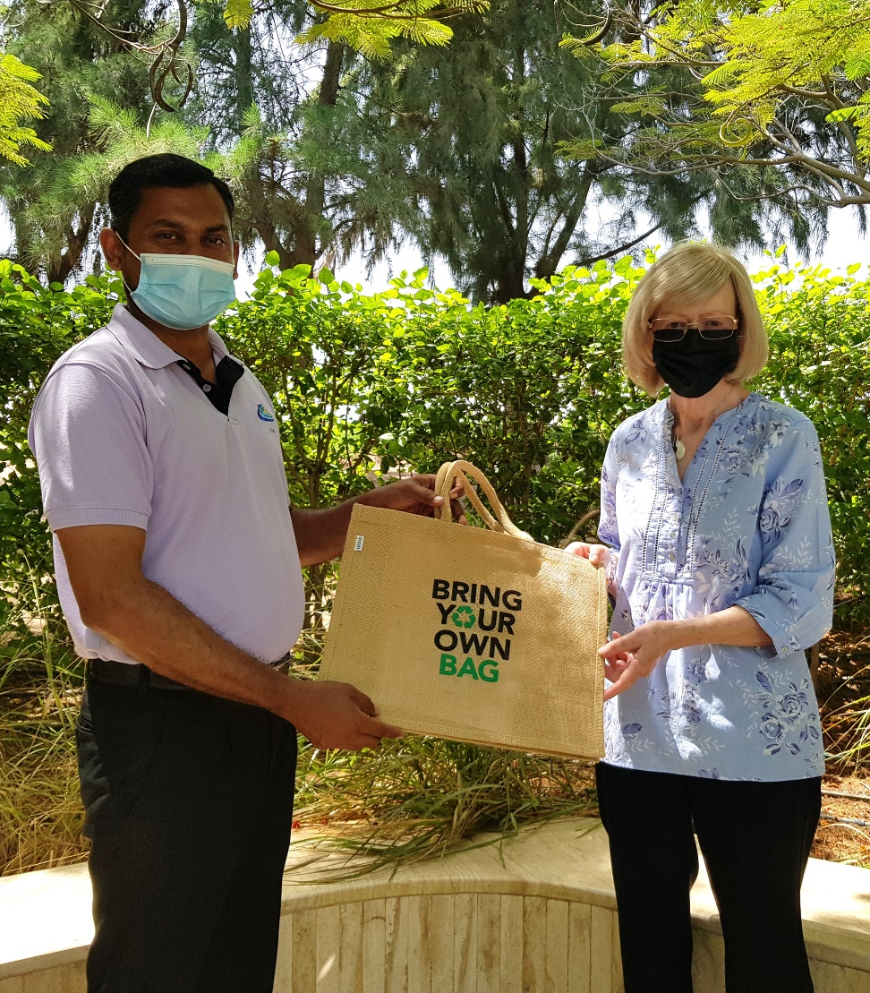
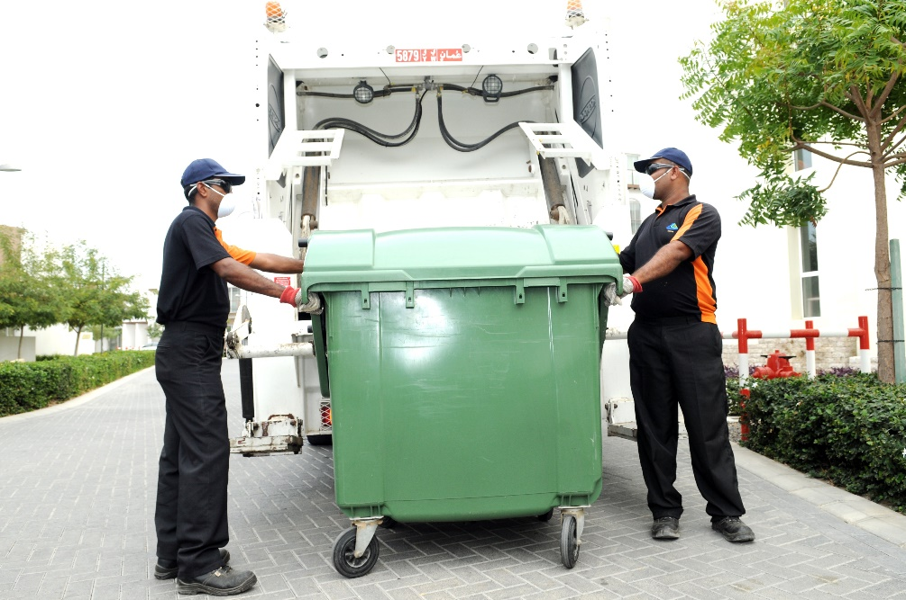
RESPONSIBLE
GREEN
ENVIRONMENT
Long-standing social and environmental leadership in our sector
Sustainability at the core
SAFE
Pursue zero levels of error, harm and loss
EFFICIENT
Digitisation, monitoring, reporting
GREEN
Optimising operational efficiency
and business process excellence
LOCAL
Nurturing a new generation of Omani leaders
RENAISSANCE 2.0
Platform for exponential growth

Slide 14
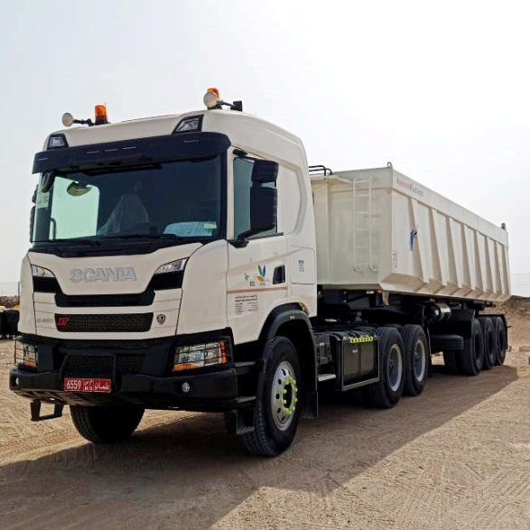
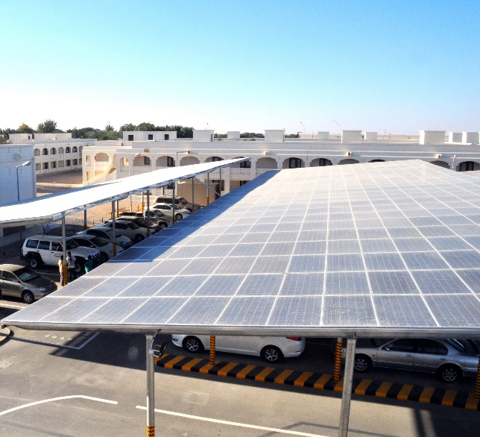
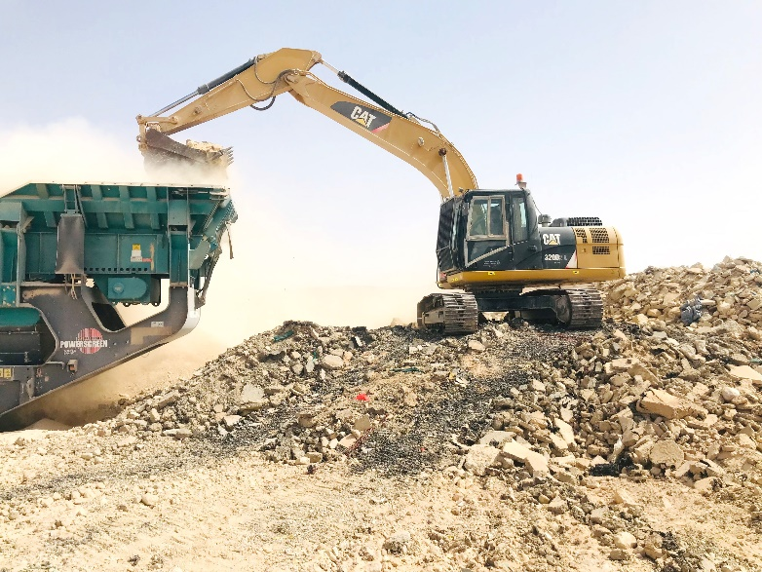
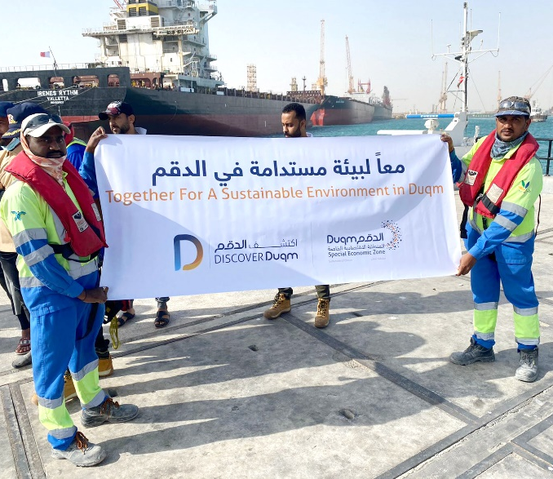
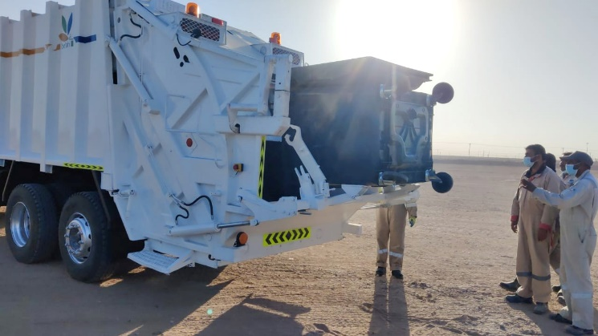
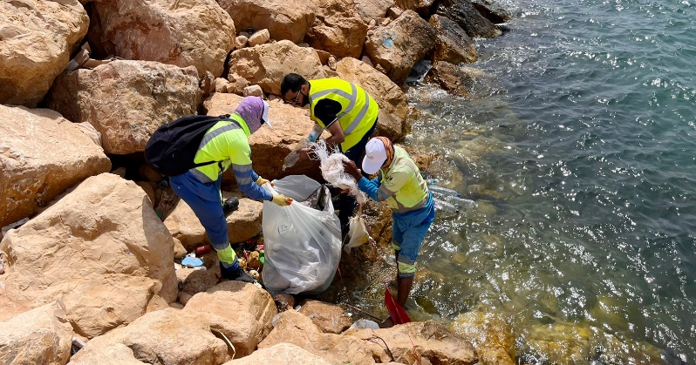
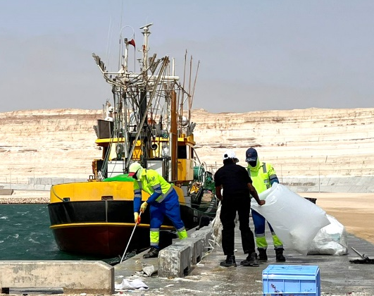
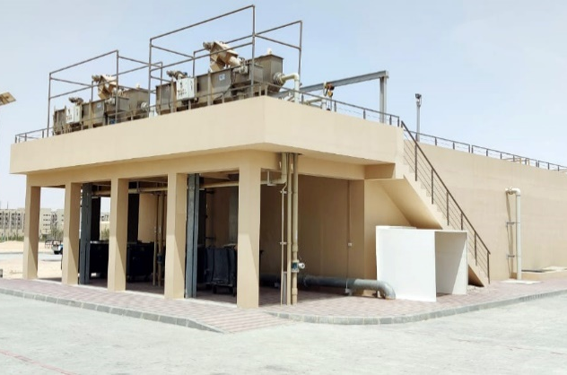






Slide 15


POSITIVE
LOCAL IMPACT
Aligned to Oman Vision 2040 and creating social-economic impact and value
Active role in the socio-economic development
HERE FOR OMAN
Omani jobs, training and development
SME DEVELOPMENT
Supporting and nurturing Omani businesses
INVESTING IN OMAN
Domestic investment in permanent facilities by an Omani public company
DIVERSITY & INCLUSION
Great place to work for Omanis
VALUE CREATION
Socio-economic development

Slide 16








Slide 17






Slide 18





Slide 19


FUTURE-FOCUSED INNOVATION
Leveraging digitalisation to offer meaningful innovation for the businesses we serve.
Continuously evolving
SMART CAMPUS
Digital, technology, AI and automation solutions
IoT
Real-time and predictive data
GREEN
Optimising operational efficiency
and business process excellence
LOCAL
Nurturing a new generation of Omani leaders.
RENAISSANCE 2.0
Platform for exponential growth

Slide 20






